Slide 1
Domain ML
Technology: Python
MULTIPLE DISEASE DETECTION (DIABETES, CHRONIC KIDNEY, LEVER DISEASE, BREAST,SKIN CANCER)

Slide 2
Domain ML
Technology: Python
PROBLEM STATEMENT
The problem statement is to develop a machine learning model that can accurately detect multiple diseases including diabetes, chronic kidney disease, liver disease, and breast cancer. The model should be trained on relevant medical data such as patient demographics, medical history, symptoms, and diagnostic test results. The goal is to create a system that can aid in early disease detection and diagnosis, potentially improving patient outcomes and reducing healthcare costs. The model should also be robust and generalizable, able to perform accurately on new patient data from different populations and geographic regions.

Slide 3
ABSTRACT
Globally, there is a substantial unmet need to diagnose various diseases effectively. The complexity of the different disease mechanisms and underlying symptoms of the patient population presents massive challenges to developing the early diagnosis tool and effective treatment. Machine Learning (ML) an area of Artificial Intelligence (AI), enables researchers, physicians, and patients to solve some of these issues. Based on relevant research, this review explains how Machine Learning (ML). Early detection and diagnosis of diseases such as diabetes, chronic kidney disease, liver disease, and breast cancer is crucial for improving patient outcomes and reducing healthcare costs. In recent years, machine learning has emerged as a promising tool for disease detection and diagnosis. In this project, we aim to develop a machine learning model for multiple disease detection, which can aid in early disease diagnosis and treatment. The proposed model will be trained on a large dataset of medical records, which includes patient demographics, medical history, symptoms, and diagnostic test results. The dataset will be carefully curated and pre-processed to ensure high data quality and completeness. We will also incorporate relevant features such as genetic markers and lifestyle factors, which have been shown to influence disease risk.
Keywords: Machine Learning, Decision tree, Adaboost , Xgboost and Catboost and ML techniques, evaluation.

Slide 4
INTRODUCTION
Multiple Disease Detection is an emerging technology that aims to detect the presence of multiple diseases simultaneously. The technology utilizes advanced data analytics and machine learning algorithms to analyze data from multiple sources, such as medical records, lab reports, and imaging studies, to provide a comprehensive diagnosis of multiple diseases.The technology has shown great promise in the early detection and management of several chronic diseases, including Diabetes, Chronic Kidney Disease, Liver Disease, and Breast Cancer. These diseases are among the leading causes of morbidity and mortality worldwide, and early detection and intervention can significantly improve patient outcomes.Diabetes is a chronic disease characterized by high levels of blood sugar. Early detection of diabetes can prevent complications such as blindness, kidney disease, and nerve damage. Chronic Kidney Disease is a progressive disease that can lead to kidney failure if left untreated. Early detection and management can slow down the progression of the disease and prevent kidney failure.Liver Disease is a broad term used to describe any condition that affects the liver. Early detection of liver disease can prevent liver damage and improve liver function.

Slide 5
As technology continues to advance, we can expect to see even more sophisticated tools and techniques for detecting and managing multiple diseases. Within the aging population, the frequency of cancer is increasing dramatically. In addition, multiple genetic and environmental factors lead to common multifactorial diseases, including cardiovascular disease, chronic kidney disease, chronic obstructive pulmonary disease, and metabolic-associated fatty liver disease. In recent years, there has been a growing awareness of the connection between cancer and multifactorial diseases, as well as how one can affect the other, resulting in a vicious cycle. Although the exact mechanistic explanations behind this remain to be fully explored, some progress has been made in uncovering the common pathologic mechanisms. In this review, we focus on the nature of the link between cancer and common multifactorial conditions, as well as specific shared mechanisms, some of which may represent either preventive or therapeutic targets. Rather than organ-specific interactions, we herein focus on the shared mechanisms among the multifactorial diseases, which may explain the increased cancer risk. More research on this subject will highlight the significance of developing new drugs that target multiple systems rather than just one disease.

Slide 6

Literature survey:
S. No | Journal Type with year | Authors | Title | Outcomes
1 | Conference ICT, vol. 5, no. 7, pp. 650–653 | J. L. Scully | ‘‘What is a disease?’’ | Chronic diseases
2 | Conference , vol. 29, no. 22, pp. 2909–2917, Nov. 2013 | R. Leaman, R. Islamaj Dogan, and Z. Lu | , ‘‘DNorm: Disease name normalization with pairwise learning to rank,’’ | NCBI disease corpus and the MEDIC vocabulary
3 | ” Conference , vol. 120, pp. 208–214, Nov. 2014. | N. Armstrong and P. Hilton | ‘‘Doing diagnosis: Whether and how clinicians use a diagnostic tool of uncertain clinical utility,’’ | Diagnosis
4 | Conference vol. 2009, p. 116, Mar. 2009 | R. H. Scheuermann, W. Ceusters, and B. Smith | ‘‘Toward an ontological treatment of disease and diagnosis,’’ | clinical phenotypes

Slide 7
EXISTING SYSTEM
The existing system of multiple disease detection using machine learning employs algorithms that can analyze medical data and identify patterns to predict the risk of developing diabetes, chronic kidney disease, liver disease, and breast cancer. This system uses various features such as patient demographics, medical history, symptoms, and laboratory test results to generate accurate predictions. By leveraging machine learning techniques, this system can continuously learn and improve its predictive accuracy, providing early detection and potentially life-saving interventions for patients at risk of developing these diseases.
Disadvantages:
High complexity.
Time consuming.

Slide 8
PROPOSED SYSTEM
The proposed system of multiple disease detection using machine learning involves the development of a model that can accurately detect the presence of four diseases - diabetes, chronic kidney disease, liver disease, and breast cancer - using patient data. The system will use various machine learning algorithms to analyze patient data such as medical history, symptoms, and laboratory test results to identify patterns and predict the likelihood of disease. The system will provide clinicians with accurate and timely information to improve patient outcomes, reduce costs, and optimize healthcare delivery. This will be accomplished through a user-friendly interface and integration with electronic medical records.
Advantages:
Highest accuracy
Reduces time complexity.
Easy to use

Slide 9
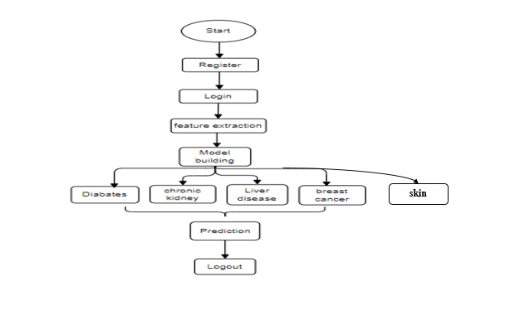
PROPOSED METHOD

Slide 10
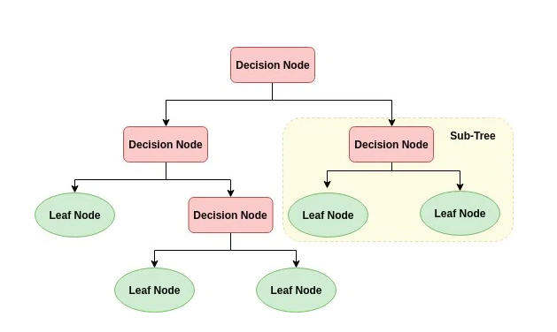
ALGORITHMS
Decision Tree:
Decision tree is a flowchart-like tree structure where an internal node represents feature(or attribute), the branch represents a decision rule, and each leaf node represents the outcome. The topmost node in a decision tree is known as the root node. It learns to partition on the basis of the attribute value. It partitions the tree in recursively manner call recursive partitioning. This flowchart-like structure helps you in decision making. It's visualization like a flowchart diagram which easily mimics the human level thinking. That is why decision trees are easy to understand and interpret.

Slide 11
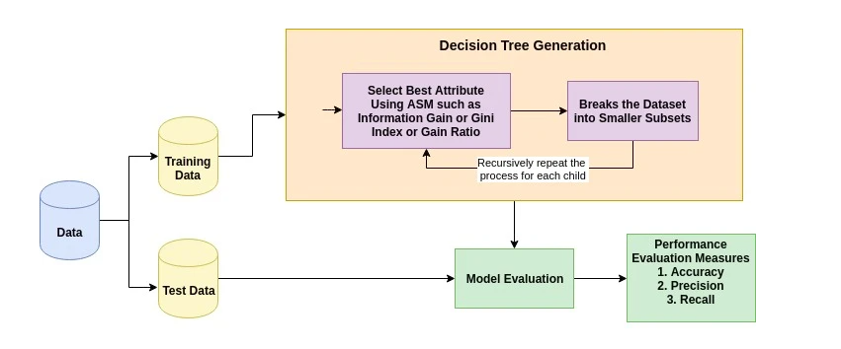
The basic idea behind any decision tree algorithm is as follows:
Select the best attribute using Attribute Selection Measures (ASM) to split the records.
Make that attribute a decision node and breaks the dataset into smaller subsets.
Starts tree building by repeating this process recursively for each child until one of the conditions will match:
All the tuples belong to the same attribute value.
There are no more remaining attributes.
There are no more instances.

Slide 12
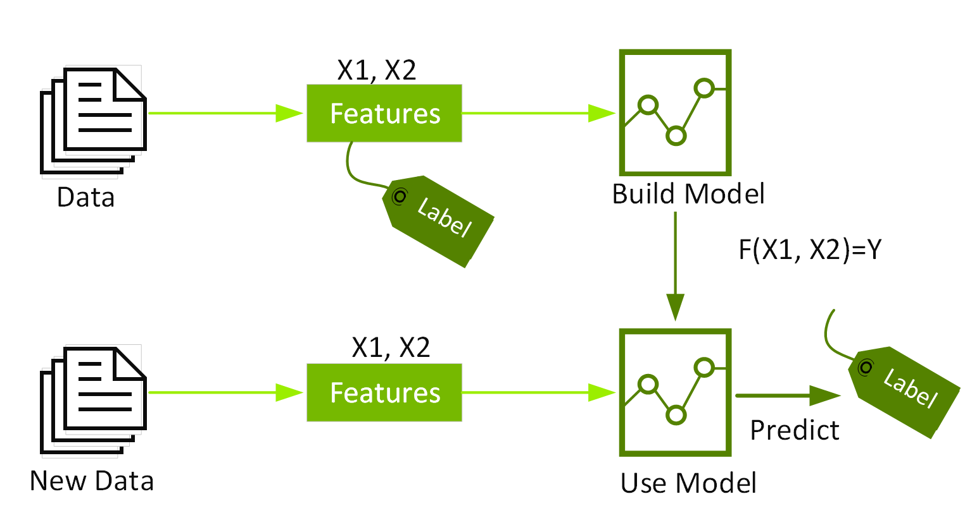
XGBoost:
Extreme Gradient Boosting (XGBoost) is a scalable, distributed gradient-boosted decision tree (GBDT) machine learning framework. It is the top machine learning package for regression, classification, and ranking tasks, and it supports parallel tree boosting.To understand XGBoost, you must first understand the machine learning ideas and methods on which it is based: supervised machine learning, decision trees, ensemble learning, and gradient boosting.Supervised machine learning use algorithms to train a model to detect patterns in a dataset containing labels and features, and then employs the trained model to predict the labels on the features of a new dataset.

Slide 13
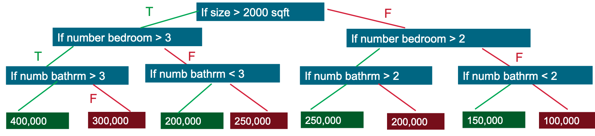
By evaluating a tree of if-then-else true/false feature questions and estimating the minimum number of questions required to assess the probability of making a correct decision, decision trees generate a model that predicts the label. Decision trees can be used to predict a category or a continuous numeric value using classification or regression. A decision tree is used in the basic example below to predict a property price (the label) based on the size and number of bedrooms (the features).
Gradient Boosting Decision Trees (GBDT) is a decision tree ensemble learning algorithm for classification and regression that is similar to random forest. To create a better model, ensemble learning techniques mix different machine learning methods.Both random forest and GBDT construct a model from multiple decision trees. The distinction is in how the trees are constructed and joined.

Slide 14
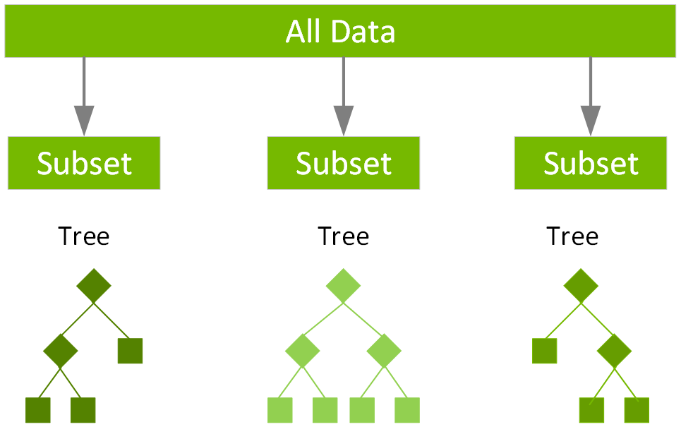
Random forest uses a technique called bagging to build full decision trees in parallel from random bootstrap samples of the data set. The final prediction is an average of all of the decision tree predictions.

Slide 15
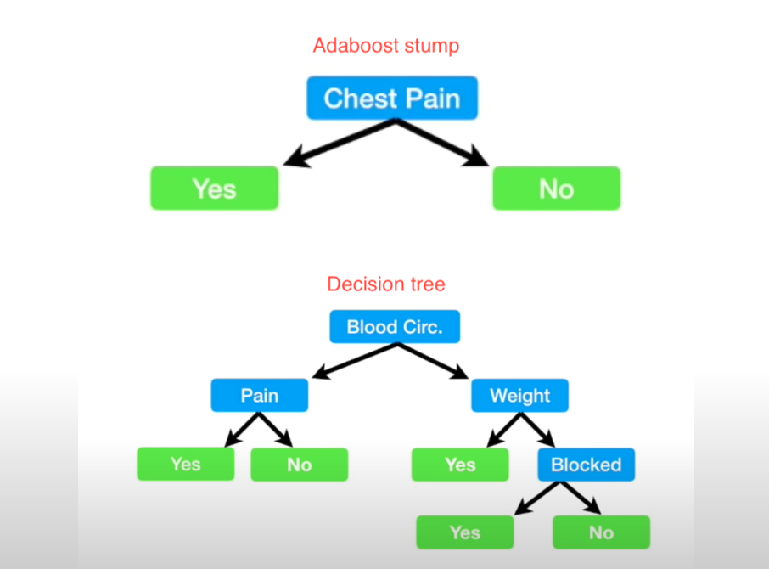
3.AdaBoost Algorithm:
AdaBoost also called Adaptive Boosting is a technique in Machine Learning used as an Ensemble Method. The most common algorithm used with AdaBoost is decision trees with one level that means with Decision trees with only 1 split. These trees are also called Decision Stumps.

Slide 16
AdaBoost algorithm, short for Adaptive Boosting, is a Boosting technique used as an Ensemble Method in Machine Learning. It is called Adaptive Boosting as the weights are re-assigned to each instance, with higher weights assigned to incorrectly classified instances. Boosting is used to reduce bias as well as variance for supervised learning. It works on the principle of learners growing sequentially. Except for the first, each subsequent learner is grown from previously grown learners. In simple words, weak learners are converted into strong ones. The AdaBoost algorithm works on the same principle as boosting with a slight difference. Let’s discuss this difference in detail.
Let us discuss how boosting works. It makes ‘n’ number of decision trees during the data training period. As the first decision tree/model is made, the incorrectly classified record in the first model is given priority. Only these records are sent as input for the second model. The process goes on until we specify a number of base learners we want to create. Remember, repetition of records is allowed with all boosting techniques. These data science challenges give a global forum for learning, researching, and solving corporate and government problems. Boosting algorithms combine many low accuracy (weak) models to produce high accuracy (strong) models. It may be used in a variety of fields, including credit, insurance, marketing, and sales. Machine learning techniques such as AdaBoost, Gradient Boosting, and XGBoost are extensively utilized to win data science contests. In this course, you will learn about the AdaBoost ensemble boosting method.

Slide 17
CATBOOST:
CatBoost or Categorical Boosting is an open-source boosting library developed by Yandex. In addition to regression and classification, CatBoost can be used in ranking, recommendation systems, forecasting and even personal assistants.
Handling categorical features:
Often datasets contain categorical features and there are various techniques to handle categorical features in boosted trees. Unlike other gradient boosting algorithms (require numeric data), CatBoost automatically handles categorical features. One of the most common techniques for handling categorical data is one-hot encoding, but it becomes infeasible with many features. To tackle this, features are grouped in categories by target statistics (estimate target value for each category). Target statistics can be calculated in different ways: Greedy, Hold out, Leave one out and Ordered. CatBoost uses Ordered target statistics.

Slide 18
The greedy approach takes an average of the target for a category group. But it suffers from target leakage as the target value is being used to calculate a representation for the categorical variables and then using those features for prediction ( is calculated using target ). The Holdout method tries to reduce this by partitioning the training data set. But this significantly reduces the effective use of training data. Leave one out excludes the target sample but is not very effective. Ordered target statistics are inspired by Online Learning algorithms which get the training examples sequentially in time. It introduces artificial time, that is, a random permutation of the training examples. It will only rely on the training examples encountered in its past (samples occurred before that particular sample in the artificial time) thereby avoiding target leakage.
CatBoost advantages
CatBoost implements oblivious decision trees (binary tree in which same features are used to make left and right split for each level of the tree) thereby restricting the features split per level to one, which help in decreasing prediction time.
It handles categorical features effectively by ordered target statistics.
It is easy to use with packages in R and Python.
It has effective usage with default parameters thereby reducing the time needed for parameter tuning.

Slide 19
HARDWARE AND SOFTWARE REQUIREMENTS
H/W Configuration:
Operating system : Windows 7 or 7+
RAM : 8 GB
Hard disc or SSD : More than 500 GB
Processor : Intel 3rd generation or high or Ryzen with 8 GB Ram
S/W Configuration:
Software’s : Python 3.6 or high version
IDE : PyCharm.
Framework : Flask, pandas, numpy and Scikit-Learn

Slide 20
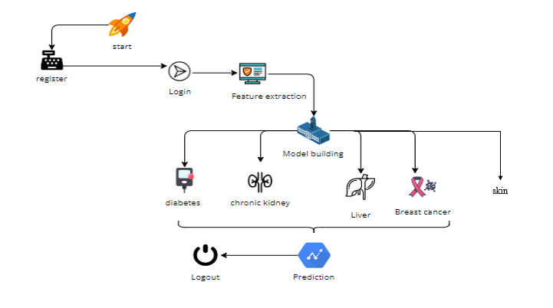
ARCHITECTURE:

Slide 21
UML DIAGRAMS :
UML stands for Unified Modelling Language. UML is a standardized general-purpose modelling language in the field of object-oriented software engineering. The standard is managed, and was created by, the Object Management Group.
The goal is for UML to become a common language for creating models of object-oriented computer software. In its current form UML is comprised of two major components: a Meta-model and a notation. In the future, some form of method or process may also be added to; or associated with, UML.
The Unified Modelling Language is a standard language for specifying, Visualization, Constructing and documenting the artefacts of software system, as well as for business modelling and other non-software systems.
The UML represents a collection of best engineering practices that have proven successful in the modelling of large and complex systems.
The UML is a very important part of developing objects-oriented software and the software development process. The UML uses mostly graphical notations to express the design of software projects.

Slide 22
GOALS:
The Primary goals in the design of the UML are as follows:
Provide users a ready-to-use, expressive visual modelling Language so that they can develop and exchange meaningful models.
Provide extendibility and specialization mechanisms to extend the core concepts.
Be independent of particular programming languages and development process.
Provide a formal basis for understanding the modelling language.
Encourage the growth of OO tools market.
Support higher level development concepts such as collaborations, frameworks, patterns and components.
Integrate best practices.

Slide 23
USE CASE DIAGRAM
A use case diagram in the Unified Modeling Language (UML) is a type of behavioral diagram defined by and created from a Use-case analysis.
Its purpose is to present a graphical overview of the functionality provided by a system in terms of actors, their goals (represented as use cases), and any dependencies between those use cases.
The main purpose of a use case diagram is to show what system functions are performed for which actor. Roles of the actors in the system can be depicted.

Slide 24
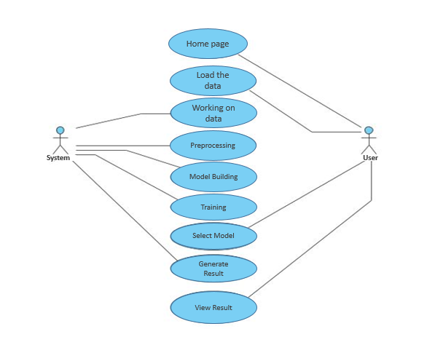

Slide 25
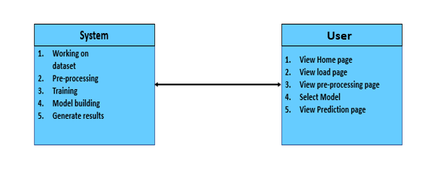
CLASS DIAGRAM
In software engineering, a class diagram in the Unified Modeling Language (UML) is a type of static structure diagram that describes the structure of a system by showing the system's classes, their attributes, operations (or methods), and the relationships among the classes. It explains which class contains information

Slide 26
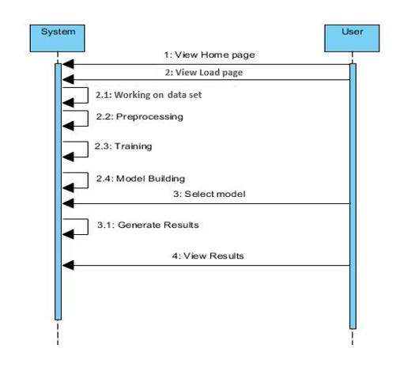
SEQUENCE DIAGRAM
A sequence diagram in Unified Modeling Language (UML) is a kind of interaction diagram that shows how processes operate with one another and in what order.
It is a construct of a Message Sequence Chart. Sequence diagrams are sometimes called event diagrams, event scenarios, and timing diagrams

Slide 27
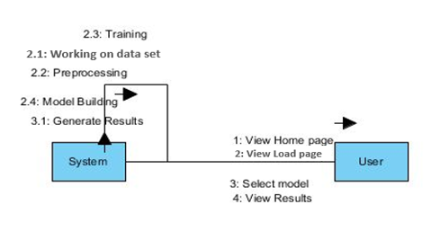
COLLABORATION DIAGRAM:
In collaboration diagram the method call sequence is indicated by some numbering technique as shown below. The number indicates how the methods are called one after another. We have taken the same order management system to describe the collaboration diagram. The method calls are similar to that of a sequence diagram. But the difference is that the sequence diagram does not describe the object organization whereas the collaboration diagram shows the object organization.

Slide 28
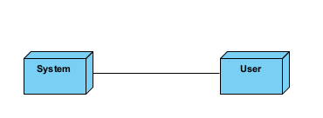
DEPLOYMENT DIAGRAM
Deployment diagram represents the deployment view of a system. It is related to the component diagram. Because the components are deployed using the deployment diagrams. A deployment diagram consists of nodes. Nodes are nothing but physical hardware’s used to deploy the application.

Slide 29
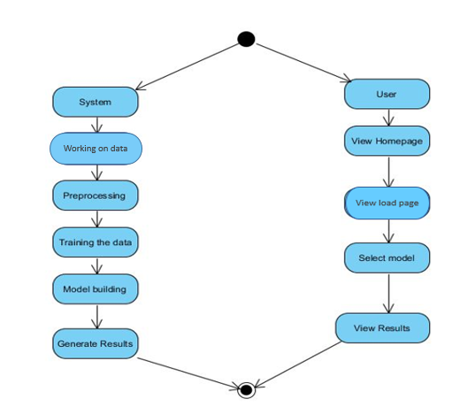
ACTIVITY DIAGRAM:
Activity diagrams are graphical representations of workflows of stepwise activities and actions with support for choice, iteration and concurrency. In the Unified Modelling Language, activity diagrams can be used to describe the business and operational step-by-step workflows of components in a system. An activity diagram shows the overall flow of control.

Slide 30
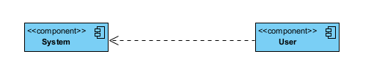
COMPONENT DIAGRAM:
A component diagram, also known as a UML component diagram, describes the organization and wiring of the physical components in a system. Component diagrams are often drawn to help model implementation details and double-check that every aspect of the system's required function is covered by planned development.

Slide 31
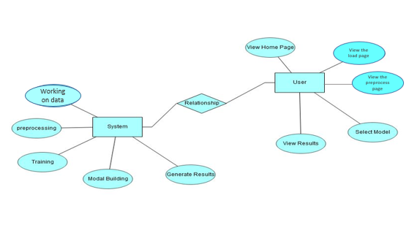
ER DIAGRAM:
An Entity–relationship model (ER model) describes the structure of a database with the help of a diagram, which is known as Entity Relationship Diagram (ER Diagram). An ER model is a design or blueprint of a database that can later be implemented as a database. The main components of E-R model are: entity set and relationship set.
An ER diagram shows the relationship among entity sets. An entity set is a group of similar entities and these entities can have attributes. In terms of DBMS, an entity is a table or attribute of a table in database, so by showing relationship among tables and their attributes, ER diagram shows the complete logical structure of a database. Let’s have a look at a simple ER diagram to understand this concept.

Slide 32
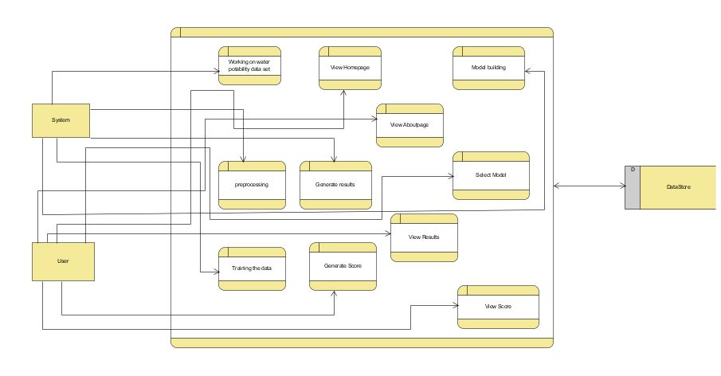
DFD DIAGRAM:
A Data Flow Diagram (DFD) is a traditional way to visualize the information flows within a system. A neat and clear DFD can depict a good amount of the system requirements graphically. It can be manual, automated, or a combination of both. It shows how information enters and leaves the system, what changes the information and where information is stored. The purpose of a DFD is to show the scope and boundaries of a system as a whole. It may be used as a communications tool between a systems analyst and any person who plays a part in the system that acts as the starting point for redesigning a system.

